Slide 1

Churn
Guardian
Application to predict customer churn and segment customers for targeted retention.
| Edy Setiawan | Irfansyah Alif | Sagara Biru | Yosef Ferianto

Slide 2
ChurnGuardian
Introduction
The telecommunications industry is highly competitive, and customer churn is a significant concern. Retaining existing customers is often more cost-effective than acquiring new ones. Therefore, predicting customer churn and understanding the underlying reasons can provide invaluable insights for customer retention strategies.

Slide 3

ChurnGuardian
Background
Develop a machine learning model that predicts customer churn in the telecommunications industry with at least 80% recall score, and to segment the identified "at-risk" customers into clusters for targeted retention strategies.

Slide 4
Timeline
ChurnGuardian
Model Development
Model development is the process of creating, training, and evaluating machine learning models to solve specific problems or make informed decisions. It involves data preprocessing, model selection, training, evaluation, and, if successful, deployment in real-world applications. Ongoing monitoring and documentation are essential for long-term model performance.
ETL Postgre and Clean Data
Extract: Gathering data from various sources. Transform: Cleaning and structuring data for consistency. Load: Storing data in a PostgreSQL database.
Data Analyst
Tuesday
Model Deployment
Wednesday-Thursday
Data Engineer
Monday - Tuesday
Exploratory Data Analysis
Exploratory Data Analysis (EDA) is the process of summarizing, visualizing, and understanding a dataset. It involves assessing data quality, identifying patterns, and preparing data for further analysis. EDA helps analysts gain insights and make informed decisions.
Data Scientist
Tuesday - Wednesday
Model Deployment to Hugging Face
After finishing the model and also the EDA, the final step is to deploy it to Hugging Face.
Timeline for final project

Slide 5
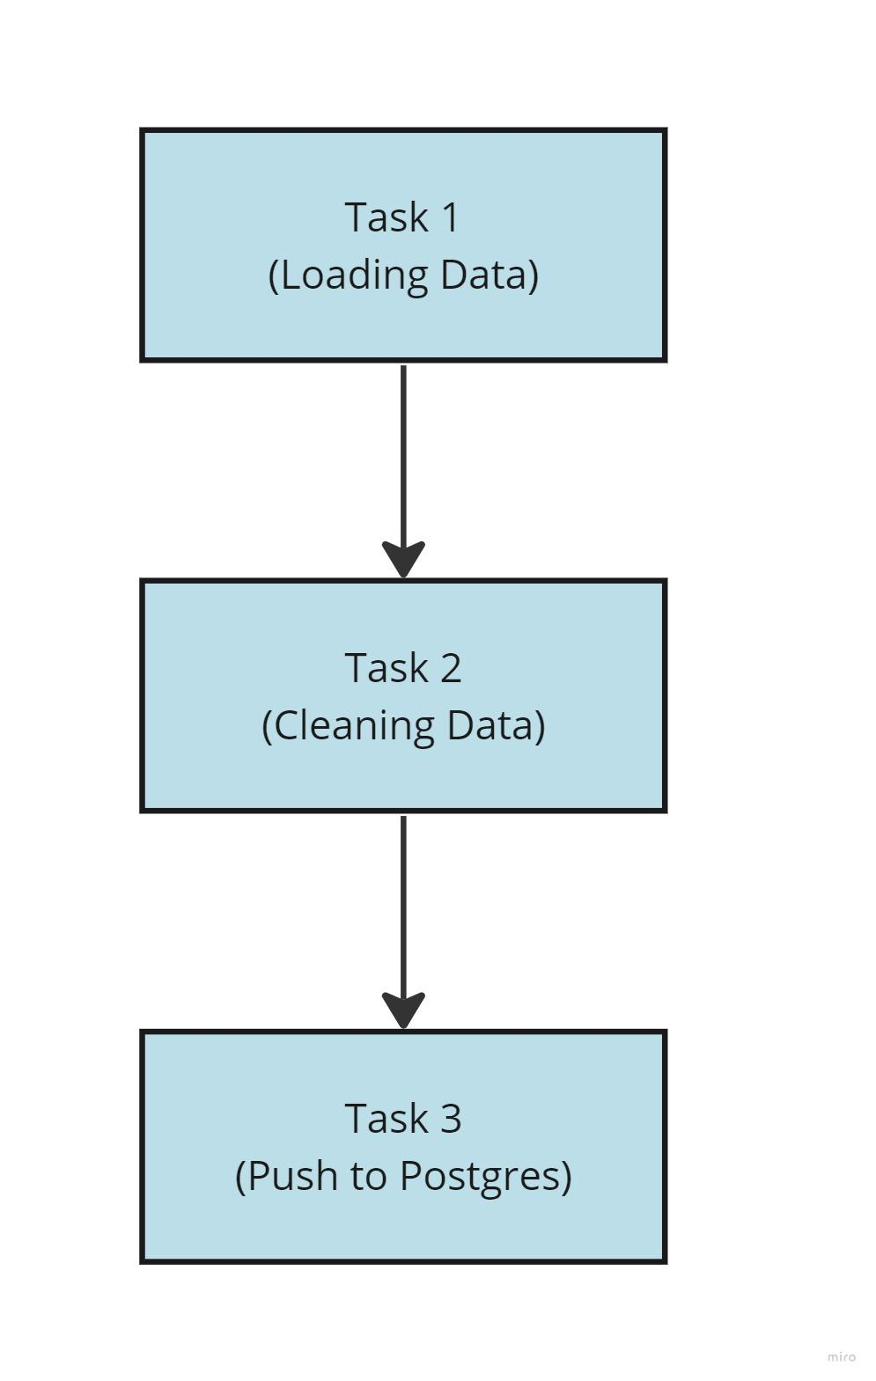
Data Engineer
Airflow
Task 1: Create database and table, and save it to csv.
Task 2: Cleaning data such as changing column names into lowercase, dropping feature customer ID, and changing zip code data type to object.
Task 3: Pushing the cleaned data to SQL server.

Slide 6
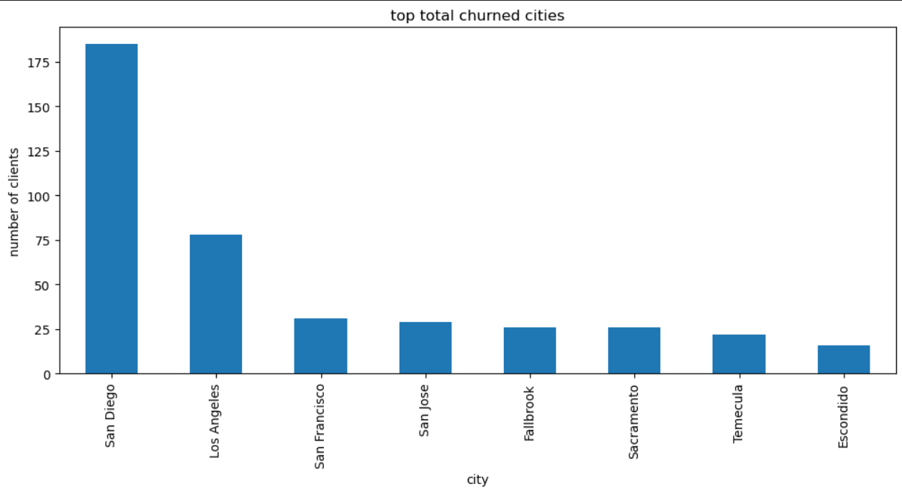
Data Analyst
Exploratory Data Analysis
The cities listed may require further investigation to understand why the churn rate is high. For example, you might want to look into customer service metrics, quality of service, or even competitive pricing in these specific locations.

Slide 7
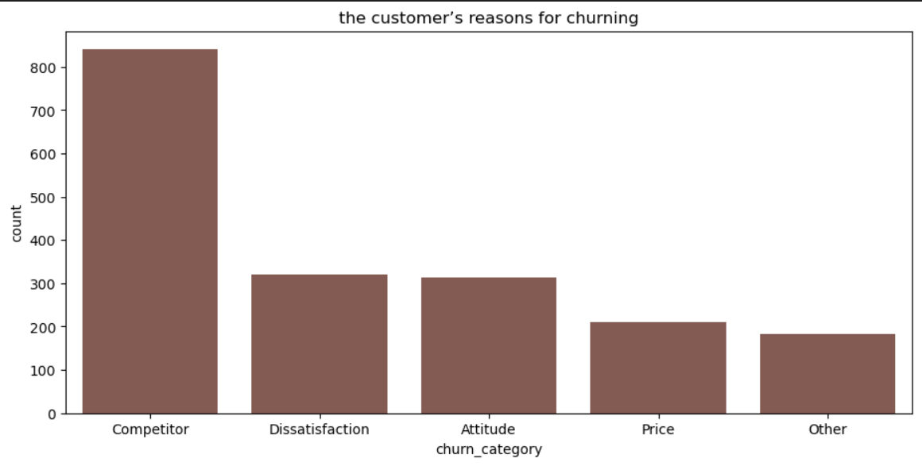
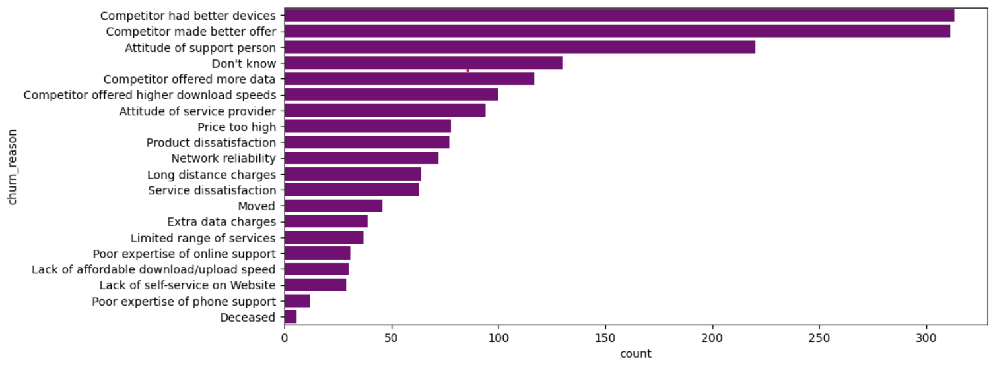
Data Analyst
Exploratory Data Analysis
Upon exploring the reasons of customers for churning, it becomes apparent that "better devices from competitors," "better offers from competitors," and "Attitude of support person" are the most commonly cited factors.
Based on the two plots, we begin to get a clearer understanding of the reasons behind customer churn. The main contributing factors appear to be:
1. The competitor providing better offers and more advanced technology.
2. Poor attitude and service quality from this company.
3. High charges levied by this company.

Slide 8
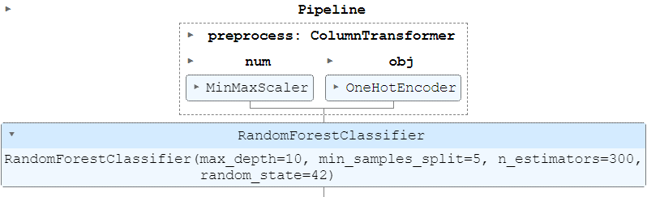
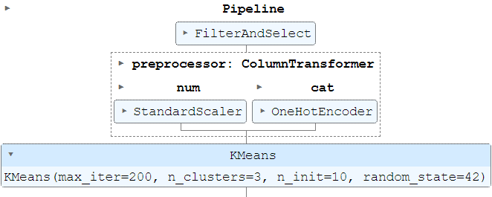
Data Scientist
Pipeline
After we finished making the model, we need to save the file as pkl and open it again for data inference. To make it easier we used pipeline to save all of the process in one pkl file. The picture above is the pipeline for classification model, and the picture below is the pipeline for clustering model.

Slide 9
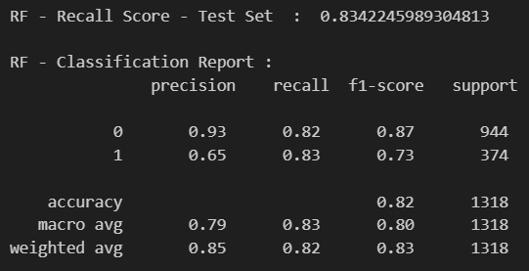
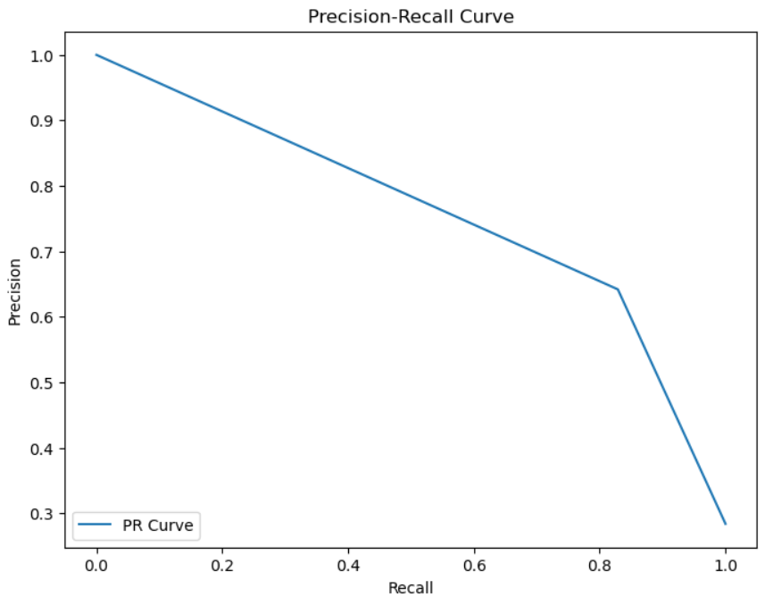
Data Scientist
Results
AUC (Area under Curve) of PR (Precision-Recall) Curve: 0.76

Slide 10
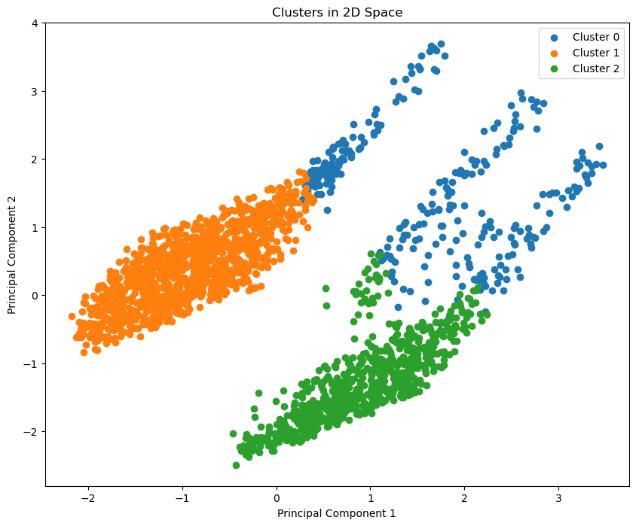
Clustering
Results
Cluster 0: Blank spot customer
Cluster 1: Minimalist customer
Cluster 2: Premium customer

Slide 11
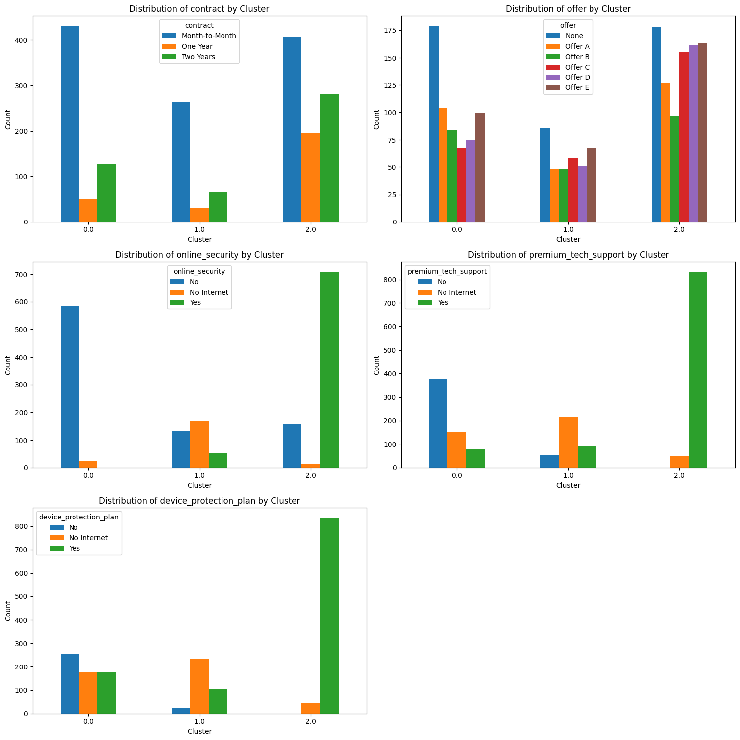
Results
EDA Clustering

Slide 12
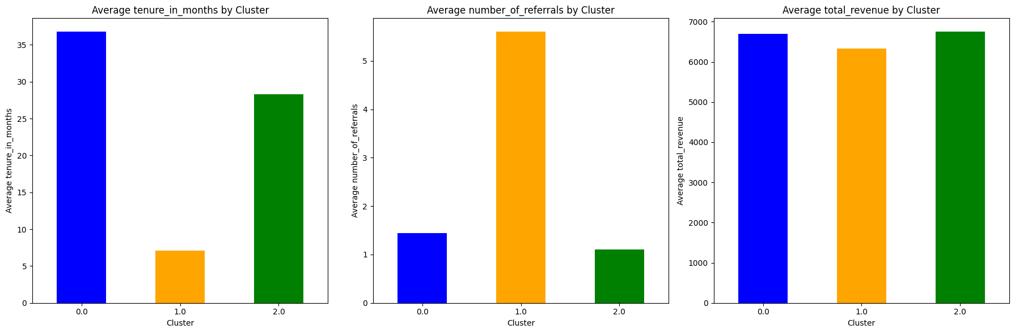
EDA Clustering
Results

Slide 13
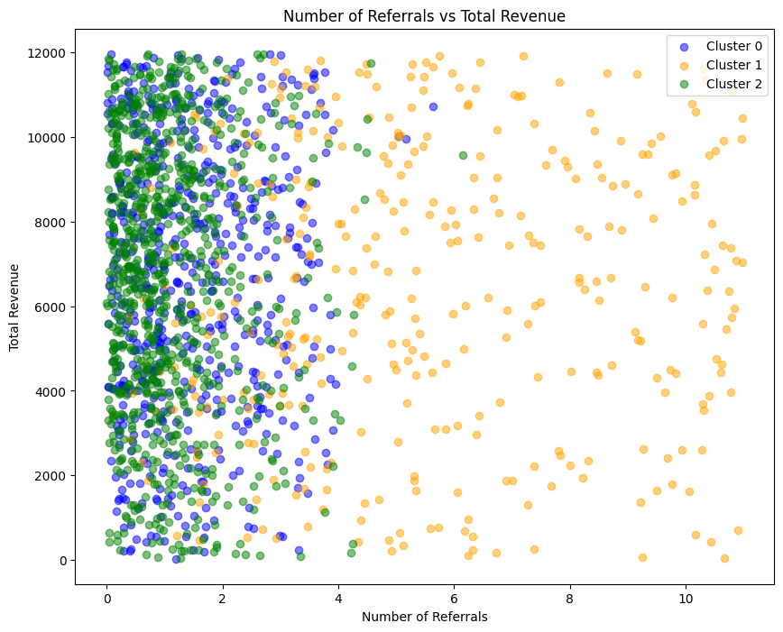
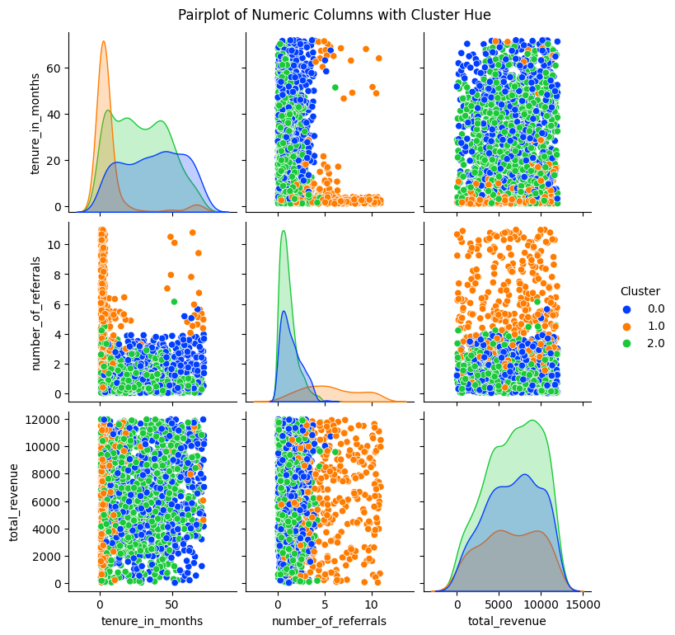
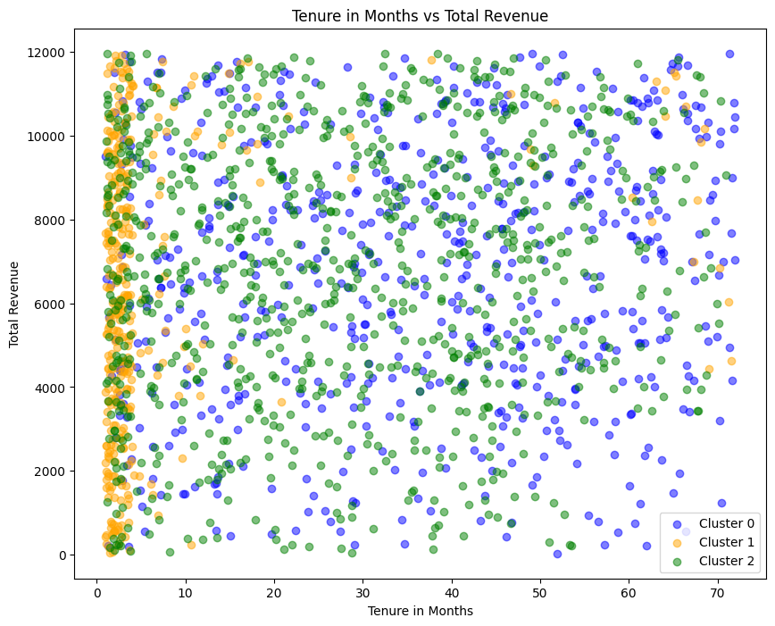
EDA Clustering
Results

Slide 14
ChurnGuardian
Challenges
Identifying missing values that actually represent customers without phone service and internet service.
Finding machine learning algorithms that are robust against overfitting
Facing challenges in creating an interactive deployment app.
Encountering challenges in merging two different types of machine learning into one.

Slide 15
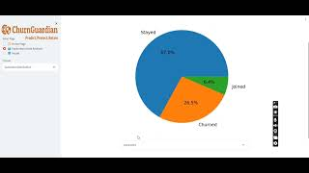
Deployment
Model Deployment with Hugging Face

Slide 16
Comparison of SAW and TOPSIS Method to Determine Road Handling Priority
Conclusion & Business Impact
Conclusion:
Successfully finding best parameter tuning for both algorithm used
Successfully combined 2 different model into one robust model
Achieved our goal with at least 80% of recall score and not overfitting
Successfully deploy interactive application and ready to be use with HuggingFace
Business Impact:
Our app hopefully can reduce churn rate of customer by at least 30%.
Classification model proven to be effective to segment customer for retention strategy.
Application model can be used by marketing to do A/B testing for retention strategy.
Model can protect business from revenue loss by customer churned.

Slide 17




Thank You
Edy Setiawan
Data Analyst
0812 8687 8725
helloiamedy@gmail.com
Irfansyah Alif
Data Engineer
0812 9643 4619
irfnnn@yahoo.com
Sagara Biru
Data Engineer
0821 2587 9433
sagara.manggala@gmail.com
Yosef Feriyanto
Data Scientist
0822 1312 5933
yosefferiyanto@gmail.com
Hacktiv8id
Hacktiv8id
Hacktiv8
Hacktiv8 Indonesia

